Slide 1
Module 7
Business understanding and data understanding
This publication was realised with the EEA Financial Mechanism 2014-2021 financial support. Its content (text, photos, videos) does not reflect the official opinion of the Programme Operator, the National Contact Point and the Financial Mechanism Office. Responsibility for the information and views expressed therein lies entirely with the author(s).

Slide 2
01
Module presentation
Table of contents
02
Security organizations
03
Data and performance
04
Good data
05
Data approach
06
Models
07
Further practice

Slide 3
01. Module presentation
1.5 hours
provide a conceptual approach to how data fits in an organization that manages security threats
Security organizations – what they are and what they do?
Why and how can data improve performance of security organizations?
Where do we find (good) data?
How should we look at data?
Notes:
Welcome to module 7!
This course will provide some examples on how abstract thinking and model-approach can offer a clearer understanding of what type of data is relevant in which analytical context.
Completing this module will help you answer the following questions about the integration of big data in the activity of security organizations:
Security organizations – what they are and what they do?
Why and how can data improve performance of security organizations?
Where do we find (good) data?
How should we look at data?
Image sources:
Outcome - https://paul4innovating.wordpress.com/2015/04/24/shifting-to-ultimate-outcomes/
Questions - https://www.womenshealthmag.com/life/a28400844/questions-that-make-you-think/

Slide 4
02. Security organizations
Security organizations
Social Function
to preserve and guarantee national security
Security defined in relation to the ”security sectors” introduced by the Copenhagen School of Thought as an analytical tool to identify different dynamics
Security defined as (1) measures the absence of threats to aquire values, and (2) the absence of fear that such values will be attacked
Intelligence organizations
Law enforcement organizations
Notes:
The activity of any organization, regardless of the field to which it belongs, can be defined based on the social function it seeks to fulfill. For security organizations, the social function cannot be any clearer – to preserve and guarantee national security.
National security is generally defined in relation to the following observations and definitions:
- Security, in an objective sense, measures the absence of threats to acquired values, in a subjective sense, the absence of fear that such values will be attacked provided by Arnold Wolfers in his reference work National security as an ambiguous symbol (1962).
- Copenhagen School of Thought placed emphasis on the non-military aspects of security, as conflicts are no longer defined exclusively in Trinitarian terms. The concept of "security sectors" is introduced as an analytical tool aimed to identify and assess different dynamics and interdependencies. The list of sectors, as listed in Security: a new framework for analysis (1997), is: military, political, societal, economic and environmental.
The activity of security organizations appears as a necessary consequence of vulnerabilities / risks / threats / dysfunctions which, unresolved, generate major negative effects on several domains - social, political, economic, military and environmental.
The responsibility to ensure security is generally divided between intelligence and law enforcement organizations. The activity of security organizations is complementary, allowing inter-institutional cooperation and information-sharing on national and transnational security-related matters.

Slide 5
transnational threats
terrorist-related activities
Security threats
illegal migration, drug trafficking, weapons of mass destruction
funding terrorist organizations, proliferation of terrorist attacks, recruiting fighters
activity that interferes with constitutional-set values
cyberintelligence & cybersecurity
espionage
fundamental rights and freedoms, extremist views that may affect social stability
cyber aggressions targeting both individuals and critical infrastructures
in any societal domain – military, economy etc.
Notes:
Currently, the threats managed by intelligence organizations are:
Any activity that interferes with constitutional-set values – e.g. fundamental rights and freedoms, extremist views that may affect social stability
Transnational threats – e.g. illegal migration, drug trafficking, weapons of mass destruction
Cyberintelligence & cybersecurity - e.g. cyber aggressions targeting both individuals and critical infrastructures
Terrorist-related activities – e.g. funding terrorist organizations, proliferation of terrorist attacks, recruiting fighters
Espionage

Slide 6
Intelligence cycle
request
collection
processing
analysis
dissemination
INPUT DATA | ALGORITHM | OUTPUT DATA
Stages 1-2 | Stages 3-4 | Stage 5
Notes:
The activity of intelligence organizations can be described as a cycle with the following stages:
Request – identification of informational needs; a stage that takes place inside the organization, as a result of internal evaluations or outside it, as a result of the explicit request of a third party (be it decision-maker, partner institution or citizen);
Collection - accessing various categories of sources, depending on the need for knowledge and respecting the legal framework;
Processing – assessment of the validity, objectivity, completeness and relevance of information collected;
Analysis – correlating information and assigning meaning;
Dissemination – analytical products are disseminated to legal beneficiaries – state representatives whose professional prerogatives allow them to determine an optimal solution to the problem; In other words, the type of knowledge provided by intelligence organizations to the political decision-maker must allow him to dispose of measures to stop the manifestation of negative effects (Kent, 1949).
If we were to describe this process in terms and principles proposed by computer science, we would have:
INPUT DATA Stages 1-2
ALGORITHM Stages 3-4
OUTPUT DATA Stage 5

Slide 7
Availability of data
Exploiting data for competitive advantage
The need for data
Crunching data could make a difference
03. Data and performance
The utility of data
Data can be used for several purposes
Notes:
Why and how can data improve performance of security organizations?
Availability of data
Technological advancements and large scale digitalization processes have determined a growth in diversity, complexity and volume of data that is available as input. Things are beginning to run on data – today’s phones, today’s wearables, home devices – they all provide a very accurate picture of what an individual prefers, what he does and where he goes. Although scary in terms of privacy, they provide enormous insight on how an individual lives, but also how he interacts with others in various social contexts. With vast amounts of data available, organizations in almost every field of activity are keen on exploiting data for competitive advantage.
The need for data
Threats targeting national security have become increasingly diverse, with sophisticated, innovative forms of manifestation. In order to survive and to fulfill its social function in the constantly-changing security environment, organizations must adapt their methodologies and instruments, develop skills and competences so as to better understand, anticipate and mitigate new forms of threats. Crunching data could make a difference. Alongside with software and technological instruments, big data could provide enhanced investigative functions within security organizations and increase the accuracy of analytical evaluations.
The utility of data
Data can be used for several purposes:
Diagnostic – to assess the status quo;
Explanatory – to assess causal relationships and identify potential consequences;
Predictive - to assess possible futures and their possibility of manifestation;
Normative – to evaluate and describe ideal states, so as to guide future decisions and processes.

Slide 8
Classification/ class estimation
Regression/ value estimation
Predictive analysis / Causal modeling
Similarity matching
Clustering
Evaluates/ predicts the probability for an entity to belong to a class. Usually the classes are mutually exclusive.
Evaluates and groups entities in a population together based on their similarity, but not driven by any specific purpose.
Evaluates/ predicts, for each entity, the numerical value of some variable for that entity.
Provides insights on causal relationships between events and actions.
Evaluates and aims to identify similar entities based on data known about them.
Data reduction
Link prediction
Profiling/ behavior description
Co-occurrence
Takes a large set of data defined by a large number of attributes and reduces the number of attributes, keeping only those with high degree of relevance.
Evaluates and aims to identify associations between entities based on transactions/ interactions involving them .
Evaluates and predicts connections between entities
Aims to describe the typical behavior of an entity.
Problems and data-driven solutions in Intelligence organizations
Notes:
Problems and data-driven solutions in intelligence organizations
Despite the large number of algorithms and analytical tasks, there are only a few of fundamental types of tasks the algorithms address.
1. Classification/ class estimation – evaluates/ predicts the probability for an entity to belong to a class. Usually the classes are mutually exclusive.
Example: type of cyberattack deployed
2. Regression/ value estimation - evaluates/ predicts, for each entity, the numerical value of some variable for that entity
Example: Common Vulnerability Scoring System (CVSS) - standard framework used to predict proneness to attack
3. Similarity matching - evaluates and aims to identify similar entities based on data known about them
Example: Twitter closed all accounts used for radical propaganda. However, in most cases, users would reopen a new account almost instantly. Similarity matching can be used to identify whether two accounts are used by the same person.
4. Clustering – evaluates and groups entities in a population together based on their similarity, but not driven by any specific purpose
Example: in semantic and content analysis, to identify communicational patterns
5. Co-occurrence – evaluates and aims to identify associations between entities based on transactions/ interactions involving them
Example: what items are commonly purchased together
6. Profiling/ behavior description – aims to describe the typical behavior of an entity
7. Link prediction – evaluates and predicts connections between entities
e.g. how information, money, influence are exchanged and transactioned within criminally organized groups
8. Data reduction - takes a large set of data defined by a large number of attributes and reduces the number of attributes, keeping only those with high degree of relevance. Although the data set becomes easier to manage and process, data reduction usually involves loss of information.
9. Predictive analysis / Causal modeling – provides insights on causal relationships between events and actions.

Slide 9
W
0100110100100001010100111101110110110110101010000111001010110010
here do we find?
GOOD DATA
INPUT DATA | ALGORITHM | OUTPUT DATA
Request collection | Processing analysis | Dissemination
In computer science, garbage in, garbage out is used to express the idea that flawed input data produces inaccurate, faulty outputs, regardless of the algorithm’s efficiency (in our case, that being analytical processes).
04. Good data
If solving the business problem is the goal, it is important to understand the strengths and limitations of data available, because rarely is an exact match with the problem.
BIG DATA
Notes:
Where do we find good data?
In computer science, garbage in, garbage out is used to express the idea that flawed input data produces inaccurate, faulty outputs, regardless of the algorithm’s efficiency (in our case, that being analytical processes).
If solving the business problem is the goal, it is important to understand the strengths and limitations of data available, because rarely is an exact match with the problem.

Slide 10
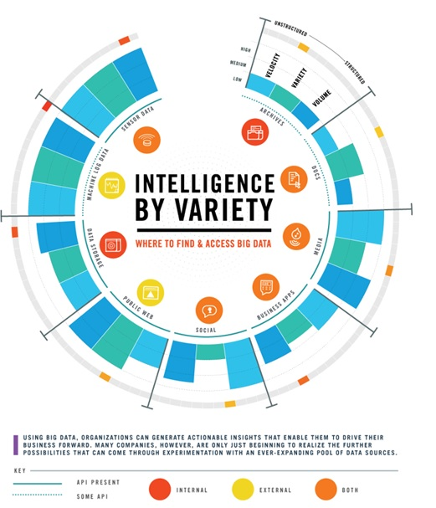
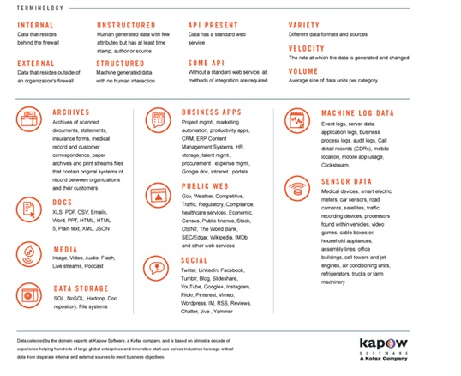

Slide 11
Various databases can contain different information, but cover intersecting populations or problems.
01
02
Depending on the data source, it can have varying degrees of reliability.
03
Not all data is reliable on the long term.
04
Costs and usage requirements may vary across data types.
05
Machine learning and artificial intelligence do not provide answers to all your problems.
06
Models to describe real world(s) replicate our own biases and understandings of the world.
07
Data at a glance
Data describes and reflects real life.
Notes:
What to keep in mind when discussing about data:
1. Various databases can contain different information, but cover intersecting populations or problems. Therefore, you can obtain a more accurate result by looking at more data inputs.
2. Depending on the data source, it can have varying degrees of reliability. Let’s take as an example social media data versus sensor data. Information that is posted on social media consciously is usually a reflection of how we want to be perceived by others, and not necessarily of how we really are. On the other hand, sensor data is usually generated unconsciously when using apps and devices in our daily activities. When trying to assess what an individual prefers, what are his interests – sensor data may be more reliable that social media data.
3. Not all data is reliable on the long term. When managing data, you have to ask yourself how long does it take for data to become irrelevant or outdated? And if so, does it still provide any useful insight on your analytical tasks? Ephemeral data is short-lived data – e.g. the minute-to-minute price of a stock that’s actively traded on the stock exchange versus durable data – e.g. the location of a building that is highly unlikely to change over time.
4. Costs and usage requirements may vary across data types. Data access is not granted and sometimes, lack of observable behavior can be due to lack of coverage.
5. Machine learning and artificial intelligence do not provide answers to all your problems. Machine learning implies working with models – computers are able to parse large amounts of data to identify those considered relevant, based on predefined criteria. So yes, from vast amounts of data, software can be deployed to find informative descriptive attributes of entities of interest. But the true analytical gain is not parsing through data, but setting a good model that answers fundamental questions like which of the data available actually provides information on the entity’s likelihood to manifest a certain behavior? How much data is required? And what are the best variables to be taken into account?
6. Models to describe real world(s) replicate our own biases and understandings of the world.
7. Data describes and reflects real life. Formulating requests and evaluating the results involves thinking carefully about both the reality they describe, and the context in which they will be used. For instance, suppose you have a dataset containing the amount of drugs illegally trafficked in recent months. In one of the months, the reported volume is zero. If we were to interpret data regardless of the reality it seeks to describe, we can just affirm drug trafficking did not happen that month. In reality though, the possibilities are endless: Has a new route been identified? Were the transactions not detected by the security organizations? Have they found a new consumer market?

Slide 12
05. Data approach
Data analysis as a strategic asset
Data and the capability to extract useful insights from data should be regarded as key strategic assets, since data can provide increased efficiency in ensuring the prevention and mitigation of threats targeting the society at large, as well as in early identification of opportunities and contexts for social welfare.
Data approach
Abstract thinking
Data analysis requires abstract thinking – the ability to use concepts, to define models (abstract representations of, processes, entities, phenomena, situations), to make and understand generalizations.
Notes:
How should we look at data?
Data analysis capability as a strategic asset
Data and the capability to extract useful insights from data should be regarded as key strategic assets, especially when discussing about national security matters. Strategic advantage in this field does not translate into economic competitiveness or larger market share, but rather in increased efficiency in ensuring the prevention and mitigation of threats targeting the society at large, as well as in early identification of opportunities and contexts for social welfare.
Too many business regard data analytics as pertaining mainly to realizing value from some existing data, and often without careful regard to whether the business has the appropriate analytical talent. (p.22)
Technology, software and datasets can lose value in the absence of a team with data-analytical thinking. Understanding the business problem and assessing correctly if and how data can improve performance become key conditions for envisioning opportunities, improving data-driven decision-making and observing competitive threats.
Abstract thinking – a necessity
Ubiquitous data becomes relatively useless unless we are able to look at the numbers, detect patterns, analyze and understand what those patterns mean. Data analysis requires abstract thinking – the ability to use concepts, to define models (abstract representations of, processes, entities, phenomena, situations), to make and understand generalizations.

Slide 13
Abstract thinking
Abstraction of systems
A system can be defined by the set of inputs, the range of possible status of the system and the rules to determine shifting from one status to the other.
Abstraction of organizations/networks
In abstract terms, an organization can be understood and analyzed from a network-based approach.
Abstraction of entities
An entity (an individual, an organization, a group, an object) is defined by its attributes, which can be tangible, or intangible.
Process abstraction
A process can be understood as an algorithm – a set of steps, taken gradually in order to achieve an objective.
Notes:
PROCESS ABSTRACTION
A process is a sequence of stages and decisions. In abstract terms, a process can be understood as an algorithm – a set of steps, taken gradually in order to achieve an objective. In computer science, all algorithms have the following:
A starting point – when resources are allocated;
Steps/ stages – when specific procedures are implemented;
Decisions – when based on specific criteria, one path is preferred over another;
Ending point – when the objective is attained.
To simplify discussions and facilitate visualization of steps, in computer science algorithms are illustrated as logical schemes.
ABSTRACTION OF ENTITIES
An entity (an individual, an organization, a group, an object) is defined by its attributes, which can be tangible, or intangible.
Tangible attributes Intangible attributes
sensorial, that have a concrete aspect do not have a physical correspondent
Economic power, dimension Know-how, copyrights
The evolution of an entity can be observed and measured in time, by assessing how its defining attributes have changed. For tangible attributes, there is usually a correspondence with statistical indicators – economic power is defined in terms of GDP, rate of investment, return of investment, etc. For intangible attributes, the process of measuring change in time becomes more difficult to attain and usually involves finding variables that correlated are good indicators of change.
ABSTRACTION OF ORGANIZATIONS/ NETWORKS
An organization consists in the multitude of its member and the relationships established between them in a certain framework, required for attaining organizational objectives. In abstract terms, an organization can be understood and analyzed from a network-based approach – members/ individuals are nodes, relationships are interactions and neighborhoods are connections. The visual representation of a social network generates a graph where the individuals are nodes and the connections between them are edges. A network analysis of how entities interact helps us to understand interpersonal or organizational dynamics, having multiple uses (eg vaccination system, streamlining public transport processes and transport infrastructure, etc.).
ABSTRACTION OF SYSTEMS
The main characteristic of a system is that it becomes unintelligible if we study its component parts in isolation, as it has new, distinct properties, not derived from their sum. A system can be defined by the set of inputs, the range of possible status of the system and the rules to determine shifting from one status to the other.
Example: national emergency systems, national systems for terrorist alert

Slide 14
06. Models
Violent Extremist Risk Assessment (VERA) model
Notes:
In the Syrian conflict, platforms such as Twitter and Facebook played a fundamental role, being used by terrorist groups to disseminate radicalization propaganda. For a large number of foreign supporters, social media became an essential source of information and inspiration. The success of their propaganda and recruitment strategy, proven by the large number of foreign fighters that have joined Daesh and initiated violent acts on its behalf, forced security organizations across the globe to develop better mechanisms for detection and prevention of foreign fighter’s radicalization processes.
Companies and researchers have tried to identify communicational patterns of terrorist groups. Leading from known propaganda sources (e.g. Dabiq, Inspire magazine) as starting points, researchers aimed to observe change in patterns once the radicalization process evolves - from simply manifesting interest towards terrorist activities to providing moral justification for violent acts and inciting to violence.
At the European level, since 2015, the EU Internet Forum brings together EU member states' law enforcement and intelligence organizations, online service providers, Europol, academia and other relevant EU networks (such as Radicalisation Awareness Network, European Strategic Communications Network), in the attempt to develop and implement monitoring and reporting mechanisms, as well as a shared protocol to online crisis. Among the online service providers partners in this endeavour are Facebook, Twitter, Youtube. The reporting mechanism is under each entity's responsibility, in accordance with the legal framework under which they operate. The early detection of terrorist content online can be done either through algorithm-based detection tools or a combination of human and machine based mechanism, all developed from models of specific communicational patterns for each platform.
Generally speaking, when building a model, a large enough dataset about radicalized individuals is needed. The process is firstly described in more general stages that are later broken down into observable behaviors.
The radicalization process involves:
a change of beliefs – individuals start to adhere to the mission and objective of the terrorist group (e.g. the caliphate)
a change of attitudes – individuals start to adhere and strictly apply the guiding principles promoted by the terrorist group e.g. strict/extremist application of Sharia law
a change of behavior – individuals initiate violent acts on behalf of the terrorist organization.

Slide 15
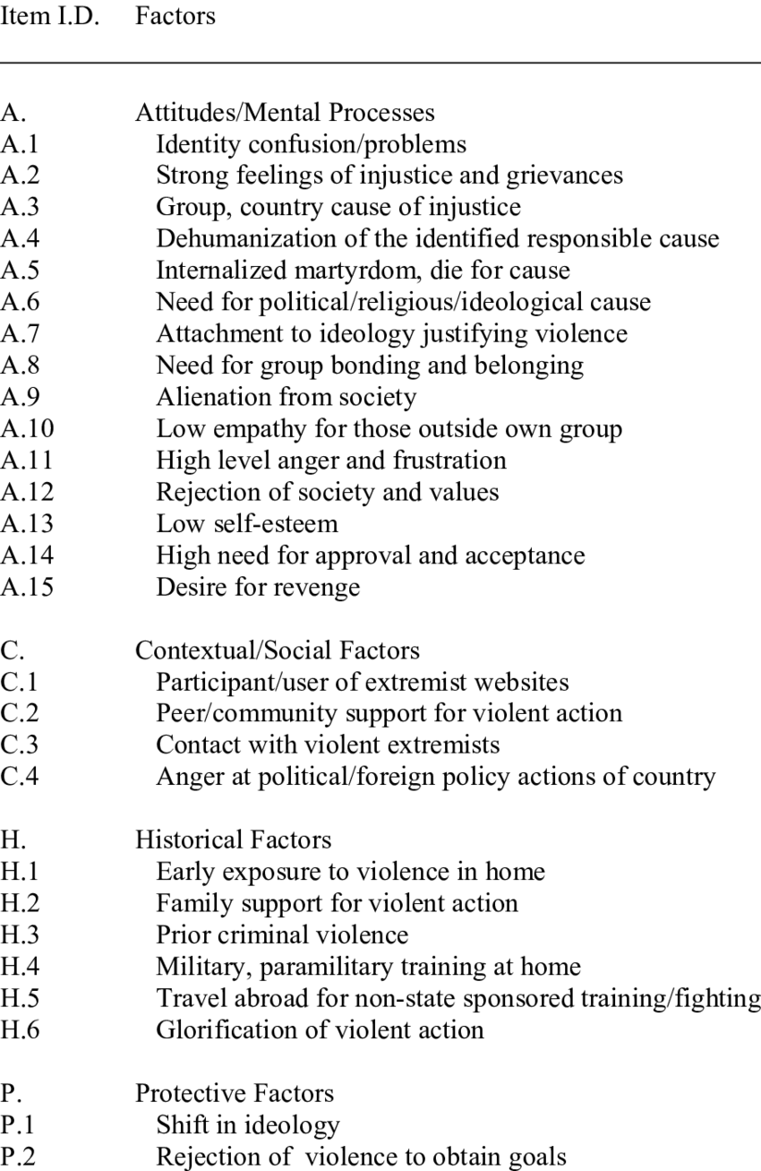
Observations:
Radicalization is not a linear progression and cannot be always described as a set of sequential steps.
Data access is not granted.
In order to truly gain anticipative insights and apply preventive measures, reviews should be done regularly.
If you have a hammer, you might see nails everywhere
Notes:
Thus, radicalization processes involves a change in the pattern of life of an individual. The observable behaviors that indicate a change towards mobilization were described and grouped by researchers and practitioners in various working models. One such a model is Violent Extremist Risk Assessment (VERA) model, developed by dr. Elaine Pressman. The indicators are categorized into four domains covering beliefs and attitudes, context and intent, history and capability and protective items, that provide for ongoing assessment of individual dynamic risk factors.
Risk Assessment Decisions for Violent Political Extremism, 2009 https://www.publicsafety.gc.ca/cnt/rsrcs/pblctns/2009-02-rdv/2009-02-rdv-eng.pdf
Observations:
Radicalization is not a linear progression and cannot be always described as a set of sequential steps. Therefore, clusters of behaviors are usually more diagnostic than separate behaviors.
Data access is not granted - Lack of observable behavior can be due to lack of coverage.
In order to truly gain anticipative insights and apply preventive measures, reviews should be done regularly.
If you have a hammer, you might see nails everywhere. Try not to become trapped into cognitive biases and always seek alternative explanations to what may seem odd behaviors.

Slide 16
07. Further practice
Exercise 1
Pick a national-security related topic of interest and define a problem. List all the data sources relevant to solving the problem and prioritize them based on credibility. Narrow down the list, by eliminating those that are not accessible.
Exercise 2
You have a new dataset that is relevant to solving your analytical problem. Put down as a logical scheme all the steps you undertake for assessing and using data.
Exercise 3
Choose an entity (it can be a person, an object - e.g. mobile phone, a corporation etc.) and list at least 3 tangible and 3 intangible attributes that define it. For the intangible attributes, think of correlating variables that can be used to observe or measure change.

Slide 17
What our smartphones reveal about our social habits, Amber Healy, 2019 https://www.futurithmic.com/2019/04/09/what-our-smartphones-reveal-about-our-social-habits/
The tradeoff between the utility and risk of location data and implications for public good, Dan Calacci, Alex Berke, Kent Larson, Alex Pentland, MIT Media Lab
Patterns of interaction predict social role in online learning, Huaiyi Sun, Dan Calacci, Alex Pentland, MIT Media Lab
Risk Assessment for Insider Threat. Critical Infrastructure, military and intelligence applications, Elaine Pressman, Romanian Intelligence Studies Review, no.15/2016
Theoretical Investigation of Terrorism. Ontology Development, Philip Galjano, Vasily Popovich, Information Fusion and Geographic Information systems, Springer, 2009
Recommended bibliography

Slide 18
THANK YOU
http://project-theseus.eu/

