Slide 1
Text Analytics / Natural Language Processing in a Policing Context
Kyle Porter
This publication was realised with the EEA Financial Mechanism 2014-2021 financial support. Its content (text, photos, videos) does not reflect the official opinion of the Programme Operator, the National Contact Point and the Financial Mechanism Office. Responsibility for the information and views expressed therein lies entirely with the author(s).

Slide 2
Preliminary Information

Slide 3
Table of Contents?
Who am I?
Goals of Course
Lecture Content: NLP, Policing, Intelligence
Open-Source Tools, Current Challenges and State-of-the-Art
Interactive Session

Slide 4
Who am I?
PhD Candidate/ Researcher in Digital Forensics
Just need to defend Dissertation.
Author of 6 academic papers. Research Highlights:
Machine Learning for Analyzing Darknet Market Forums
Carving Filesystem Metadata Records
Working with Oslo Police to apply NLP methods to police work.
Education:
BA in Mathematics
MS in Information Security/Cryptography

Slide 5
Summary of Course Module
2 hours of instruction and review
1 Hour of interactive exercises

Slide 6
Goals of Course
Understand, “what is NLP?”
Become familiarized with some of the most commonly applied kinds of NLP tasks.
Understand which have these tasks have been studied in a policing or intelligence context.

Slide 7
Goals of Course
Understand that NLP tasks can be implemented through fairly standard machine learning pipelines.
Understand some of the limitations of these methods.
Have knowledge of some open-source tools so one can apply some of these methods.

Slide 8
Questions to be Revisited at End of Module
Name three of the most common NLP tasks and describe what they do.
How might some of the NLP tasks be applicable to your work?
Can these methods replace traditional policing, intelligence, or social science analytical methods?

Slide 9
Lecture Content: NLP, Policing, Intelligence

Slide 10
What is Natural Language Processing (NLP)?
The use of linguistics and computer algorithms to attempt have computers to understand “aspects” of written or spoken text.
The algorithms used may or may not use machine learning.
Most development has been done in English.

Slide 11
NLP and Machine Learning
NLP using machine learning essentially uses the same machine learning pipeline.
Spoken or written language documents
Text Classification or Relationships
Trains
Model
Output

Slide 12
TWO major categories of ML
The two different categories the requirements of the training data, as well as the outcome of the NLP task.
Supervised:
Data is “labeled” by human.
Output is often classification.
Data
How to classify unseen doc?
: Murder-Mystery
trains
Model
?
Genre
Classification
: Fantasy
: Science Fiction

Slide 13
TWO major categories of ML
Unsupervised:
Data is unlabeled
Output is often relationships identified within the data.
trains
Possible results:
Themes: Crime, Fiction, Mystery?
Which documents are related?
Model
Now for some concrete examples of different tasks…

Slide 14
Named Entity Recognition (NER)
Concerned with extracting proper nouns from unstructured text.
Proper nouns are labeled. Labels are usually PERSON, LOCATION, ORGANIZATION, GEO-POLITICAL ENTITY, etc.
ML NER uses supervised learning. So a human must provide these labels.
You can even have industry specific labels, but would require hand annotating a lot of data.

Slide 15
Example and Metrics
“A dog, named Jimmy, went to the Walmart store in New York to buy a heroic bone”
Proper nouns are: Jimmy, Walmart, New York.
Assume algorithm identified “Jimmy” and “bone” as proper nouns.
Precision is percentage of returned results that are correctly identified as proper nouns.
Jimmy is a proper noun, bone is not. Thus the precision would be 50%.
Recall is the percentage of proper nouns identified of the total number of proper nouns in the text.
Jimmy was found, but Walmart and New York were not. Thus the recall would be 33.33%.

Slide 16
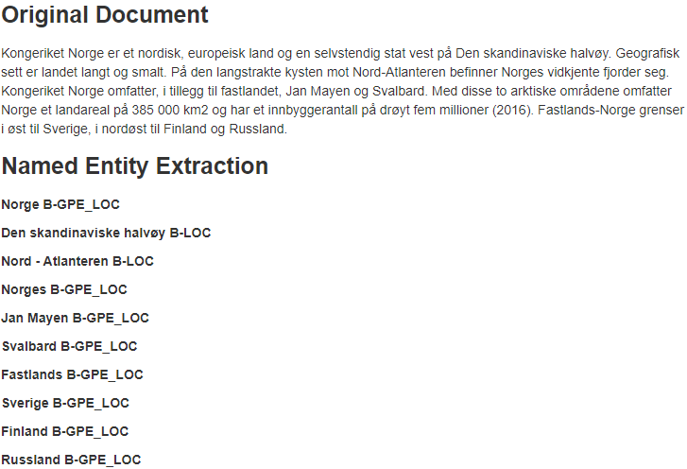
Named Entity Recognition (NER)
Can also identify PERSONS, ORGANIZATIONS, among others.

Slide 17
Interactive English Example
https://explosion.ai/demos/displacy-ent

Slide 18
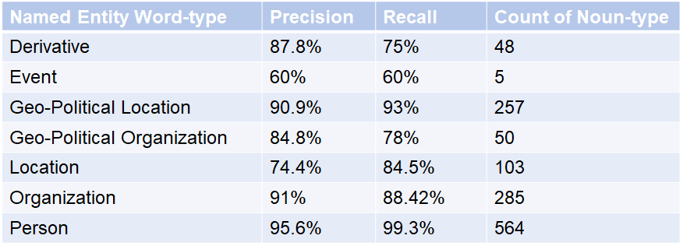
NER Results for Specific Labels
Results for analysis on a Norwegian test set.

Slide 19
Related Work to NER
Chau et al. (2002) used NER to extract names, narcotics, and addresses from unstructured police reports.
Rather than just having names, locations, organizations etc. researchers have developed datasets with more types of entities to recognize, or crime specific terms to recognize.

Slide 20
Related Work to NER
Al-Zaidy et al. used the extracted named entities and attempts to identify communities across a text document set.
E.g.
Doc 1
Doc 2
Doc 3
Taylor ~ Jared
Jared
~
Community X
Community X
~
Criminal Group

Slide 21
Related Work to NER
Using opensource tools, average Norwegian prec/recall results are about 91.5% and 92.3% respectively.
Best results for English are about 94.6%.
NTNU is currently researching applying NER to investigative interviews for the police.

Slide 22
Weaknesses of NER
Encountering words not yet seen.
Can only identify categories that you trained for.
Some types of entities are easier to identify than others.

Slide 23
Text Classification
Text Classification is the act of using computational methods to analysis whether some excerpt of text belongs to one of potentially many categories.
Research includes determining if chat log is predatory in nature (binary classification).
Measured in precision and recall.
Chat 1
Grooming or no?

Slide 24
Related Work to Text Classification
Large subdomain of NLP, referred to Forensic Linguistics.
See PAN (https://pan.webis.de/)
Classification tasks:
Authorship attribution (who wrote it?).
Author profiling (what kind of person wrote it?).
Plagiarism detection.
Recent studies showed 98.5% accuracy, and identified lines within the chat log as predatory with 77.9% precision and 70.4% recall (Ngejane et al., 2021).

Slide 25
Weaknesses of Text Classification
Classifying short texts is significantly more difficult than longer texts.
What can be classified depends upon how many categories were involved in training.
Need a balanced dataset for training.

Slide 26
Sentiment Analysis
A kind of text classification.
Give a numerical score to text, where the machine identifies the content as more positive or more negative.
Review | Score
utlander S02 E01 - 02 Fortsatt et eventyr du blir glad i. Tidsreiseeventyret Outlander, basert på Diana Gabaldons populære bokserie, kommer endelig tilbake på TV-skjermen denne uken. … | 5

Slide 27
Interactive English Examples
https://www.uclassify.com/browse

Slide 28
Related Work to Sentiment Analysis
Al-Rowaily et al. used this type of analysis for opinion and sentiment mining on bilingual textual data on dark web forums, looking for terrorist activity.
Androitis et al. classify the sentiment of short texts, as found in SMS messages and Twitter tweets. They report their results alongside a timeline, producing an “emotional fingerprint”.
Best sentiment analysis results for Norwegian is about 61.4 accuracy (rating 1 - 6) [Velldal]

Slide 29
Weaknesses of Sentiment Analysis
Same as text classification.

Slide 30
Summarization
Automatically summarize written text.
Abstractive summarization: writes a summarization of the text “in its own words”.
Extractive summarization: writes summary of the text by extracting about 3 of the most important sentences.
Few if any policing applications of summarization have been studied.

Slide 31
Summarization
Reference Summary | Generated Summary
Claim was made by the commander of Russian Space Command . Oleg Maidanovich said someone was hiding satellites as space junk. But in a film he refused to name the country behind the ruse. Comments came on the anniversary of Yuri Gagarin's first spaceight . | The claims were made by the commander of Russian Space Command , Oleg Maidanovich. The official refused to comment on how many such satellites there were, and which countries were operating them. It suggests there could be more satellites than thought monitoring different countries on Earth.

Slide 32
Interactive English Example
https://quillbot.com/summarize

Slide 33
Weaknesses of Summarization
Modern models have a limitation of the input size of the document to be summarized (typically either around 512 or 4096 words)
Metric for success is lacking.
Abstractive summarization always has the possibility of being non-sensical.

Slide 34
Topic Modelling
An item related to summarization is Topic Modelling.
Act of extracting “topics” automatically from a large number of text documents.
Unsupervised task. User chooses number of topics.
Topics are not represented by words, but groupings of words the algorithm finds to be topically similar.
Preprocessing and modelling
Topic 1
Topic 2
Topic 3
…
Topic K

Slide 35
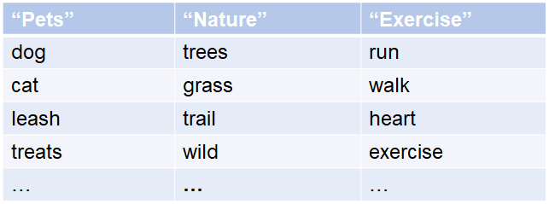
Example of topics
Extracted Topics
Lots of Docs
TopicModel
In the topic “pets” (humans provide the title, not the machine), the most probable word for the topic is “dog”.
Words further down the list are less probable.

Slide 36
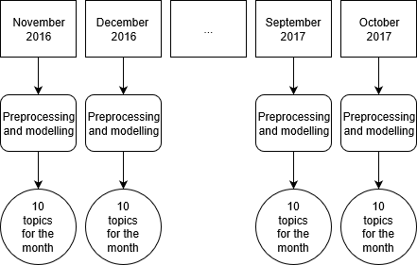
Analyzing Darknet Market Forums

Slide 37
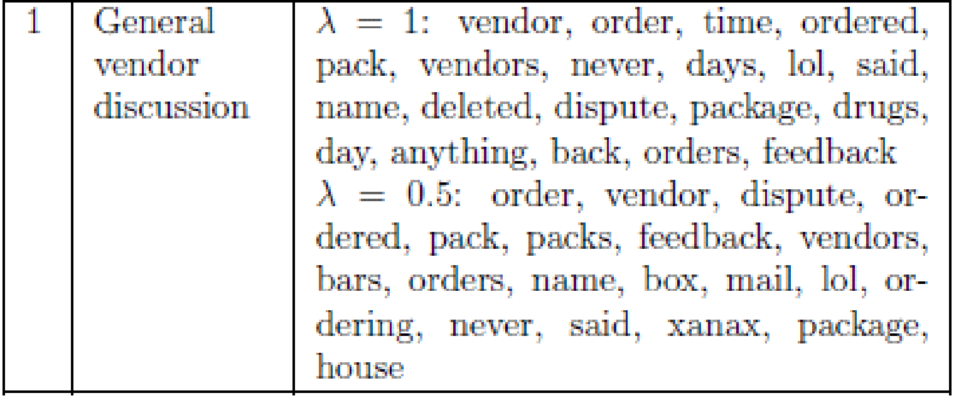
Topic Modeling Research
Summary of DarkNetMarket subreddit (May 2017)

Slide 38
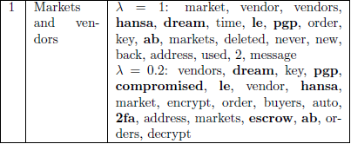
Topic Modeling Research
Summary of DarkNetMarket subreddit (July 2017)

Slide 39
Interactive English Example
https://mimno.infosci.cornell.edu/jsLDA/jslda.html

Slide 40
Related Work to Topic Modelling
Okolica et al. (2007) used Author Topic Modelling on the Enron email data-set to discover the interests of employees, and narrow down who may be an insider threat.
Beebe and Liu (2014) used it to group together search hits together. Starting at the “center” of the group allowed
Noel and Peterson (2014) used LDA topic modeling as a method of relaxing keyword selection for search. Even if a search word was not present in a document, a topically similar would still be able to find it.

Slide 41
Weaknesses of Topic Modelling
Topic modelling involves stochastic (random) elements, thus generating topic models on a corpus of documents may yield different results if parameters aren’t forced to be static.
User must chose number of topics, and there is no real rule-of-thumb for a best number of topics.
Topics may make no sense.
Topics may overlap if too few topics exist.
Topics may be too specific with respect to a document if too many topics exist.

Slide 42
Open-source tools, current challenges and state-of-the-art

Slide 43
(Programming) Open Source tools to help you get started with NLP
Note: These are state-of-the-art solutions.
Python
Scripting/programming language
https://www.python.org/
HuggingFace Transformers library
Use state-of-the-art models for NLP.
https://github.com/Hugging Face/transformers
Google Colab
Online resource to run code and use GPUs.
https://colab.research.google.com/notebooks/

Slide 44
Current Challenges in NLP field
Developing language models for “low resource” languages.
For example, Norwegian is only developing.
Creating datasets for low resource languages.
Classification, Summarization, and NER cannot be performed without the prerequisite datasets.
Improving performance of language models.
Either requires innovative research or more/better data.
Application of NLP into policing and intelligence.

Slide 45
State-of-the-Art NLP Organizations and results
Best NLP task results
https://nlpprogress.com
For updates and history of applying NLP for tasks such as author identification and grooming detection.
https://pan.webis.de/
For updates on cutting edge research in applying methods (including NLP) to policing, digital forensics, or intelligence (only some of the articles are full open access).
https://www.journals.elsevier.com/forensic-science-international-digital-investigation

Slide 46
Interactive Session

Slide 47
Questions
Name three of the most common NLP from this module, and describe what they do.

Slide 48
Possible Answers
Named Entity Recognition
Text Classification
Sentiment Analysis
Summarization
Topic Modelling
Syntax Analysis (bonus points)

Slide 49
Try it yourself!
Named Entity Recognition:
https://explosion.ai/demos/displacy-ent
Text classification / Sentiment Analysis
https://www.uclassify.com/browse
Summarization
https://quillbot.com/summarize
Topic Modelling
https://mimno.infosci.cornell.edu/jsLDA/jslda.html

Slide 50
Questions
How can NLP for policing, intelligence, or social science work fail?
NER
https://explosion.ai/demos/displacy-ent
Try different languages! How do they perform?
Are there any entities which fail more often than others?

Slide 51
Possible Answers
Mislabeling entities.
Some entity types may have poor performance.

Slide 52
Questions
How can NLP for policing, intelligence, or social science work fail?
Text Classification and Sentiment Analysis
https://www.uclassify.com/browse
How reliable are the results? Try out at least 5 different classifiers.
If a sentence is classified 45 percent negative, and 55 percent positive, what does this imply?

Slide 53
Possible Answers
Misclassification of text category.
Some classification categories may not have sufficient data to perform well.

Slide 54
Questions
How can NLP for policing, intelligence, or social science work fail?
Summarization
https://quillbot.com/summarize
Try both types of summarization! Do the summaries make sense?
How do long documents perform?

Slide 55
Possible Answers
Wrong sentences may be extracted and give misleading summary.
Data is difficult to come by.

Slide 56
Questions
How can NLP for policing, intelligence, or social science work fail?
Topic Modelling
https://mimno.infosci.cornell.edu/jsLDA/jslda.html
Try different number of topics!
Try different number of iteration runs!
How do the above affect the results?

Slide 57
Possible Answers
Topic modelling involves random elements, so different topics may be generated on different runs of the algorithm.
Smaller topics may be overlooked or merged into larger topics.
Too few topics may cause topics to be too vague.

Slide 58
Questions
How might some of the NLP tasks be applicable to your work?
Social Sciences
Political Science
Communication Analysis
Sociology

Slide 59
Questions
Can these methods replace traditional policing, intelligence, or social science interactive methods?

Slide 60
Answer
Likely not, but they can assist in expediting or enhancing the process.

Slide 61
Questions
What is the maturity of the NLP field?

Slide 62
Answer
Fairly sophisticated, but not flawless
Usefulness often requires domain specific training and data.

Slide 63
Understanding the Text Analysis Methods
When applying Named Entity Recognition, which words should be identified as named entities?
How would the entities be categorized?
“Jack thinks that the lakes in Norway have salmon that would make his workplace, Jumping Jack, very pleased.”

Slide 64
Extracted Entities:
Jack – PERSON
Norway – Geo-political Entity
Jumping Jack - Organization

Slide 65
Understanding the Text Analysis Methods
When applying polarity (positive or negative) sentiment analysis to the following sentences, how might they be categorized?
“I am delighted that the project went as planned!”
“Oh God, I cannot stand reading this again.”
“Water is composed of two hydrogen, one part oxygen.”

Slide 66
Polarities:
1. Positive
2. Negative
3. Neutral if possible.

Slide 67
Understanding the Text Analysis Methods
If using extractive summarization, how might the following text be summarized (extracting 2 sentences)?
“Teddy Roosevelt was known for many things, but his love of nature and his ‘big stick’ diplomacy were perhaps most well-known characteristics. He was even shot during a speech! On the other hand, he also had many strange pets in the white house. Overall, he was a charismatic president.”

Slide 68
Likely Extracted Sentences:
Teddy Roosevelt was known for many things, but his love of nature and his ‘big stick’ diplomacy were perhaps most well-known characteristics.
Overall, he was a charismatic president.

Slide 69
Understanding the Text Analysis Methods
How might one label define the following topics?
Santa Ornament Tree Jesus Presents Sleigh Snow Star | Tor Service Server Anonymity Hidden Web Browsing Illegal

Slide 70
Possible topic labels:
Christmas
Tor, Anonymization, possible the dark web.

Slide 71
Thanks for your attention!
Contact information:
Kyle.porter@ntnu.no
https://www.linkedin.com/in/kyle-andrew-porter-72259b169/

Slide 72
Bibliography
Andriotis, Panagiotis, Atsuhiro Takasu, and Theo Tryfonas. "Smartphone message sentiment analysis." IFIP International Conference on Digital Forensics. Springer, Berlin, Heidelberg, 2014.
Al-Rowaily, Khalid, et al. "BiSAL–A bilingual sentiment analysis lexicon to analyze Dark Web forums for cyber security." Digital Investigation 14 (2015): 53-62.
Al-Zaidy, Rabeah, et al. "Mining criminal networks from unstructured text documents." Digital Investigation 8.3-4 (2012): 147-160.
Bacciu, Andrea, et al. "Cross-Domain Authorship Attribution Combining Instance Based and Profile-Based Features." CLEF (Working Notes). 2019.
Beebe, Nicole L., and Lishu Liu. "Clustering digital forensic string search output." Digital Investigation 11.4 (2014): 314-322.
Blei, David M. "Probabilistic topic models." Communications of the ACM 55.4 (2012): 77-84.
Borj, Parisa Rezaee, and Patrick Bours. "Predatory conversation detection." 2019 International Conference on Cyber Security for Emerging Technologies (CSET). IEEE, 2019.
Chau, Michael, Jennifer J. Xu, and Hsinchun Chen. "Extracting meaningful entities from police narrative reports." Proceedings of the 2002 annual national conference on Digital government research. 2002.
Johnsen, Jan William, and Katrin Franke. "Identifying Proficient Cybercriminals Through Text and Network Analysis." 2020 IEEE International Conference on Intelligence and Security Informatics (ISI). IEEE, 2020.
Lin, Chin-Yew. "Rouge: A package for automatic evaluation of summaries." Text summarization branches out. 2004.
Ngejane, Cynthia H., et al. "Digital forensics supported by machine learning for the detection of online sexual predatory chats." Forensic science international: Digital investigation 36 (2021): 301109.
Noel, George E., and Gilbert L. Peterson. "Applicability of Latent Dirichlet Allocation to multi-disk search." Digital Investigation 11.1 (2014): 43-56.
PAN. “Sexual Predator Identification 2012.” pan.webis.de/clef12/pan12-web/sexual- predator- identification.html. 2012.
PAN. “Cross-Domain Authorship Sttribution 2019. ”pan.webis.de/clef19/pan19-web/authorship-attribution.html. 2019.
Porter, Kyle. "Analyzing the DarkNetMarkets subreddit for evolutions of tools and trends using LDA topic modeling." Digital Investigation 26 (2018): S87-S97.
Wani, Mudasir Ahmad, Nancy Agarwal, and Patrick Bours. "Sexual-predator Detection System based on Social Behavior Biometric (SSB) Features." (2021)

