Slide 1

KICK-OFF MEETING
This publication was realised with the EEA Financial Mechanism 2014-2021 financial support. Its content (text, photos, videos) does not reflect the official opinion of the Programme Operator, the National Contact Point and the Financial Mechanism Office. Responsibility for the information and views expressed therein lies entirely with the author(s).
THESEUS
DISSEMINATION
component
Decembre 5th - 6th, 2019
Romania

Slide 2
VISUAL IDENTITY rules
This publication was realised with the EEA Financial Mechanism 2014-2021 financial support. Its content (text, photos, videos) does not reflect the official opinion of the Programme Operator, the National Contact Point and the Financial Mechanism Office. Responsibility for the information and views expressed therein lies entirely with the author(s).
ILN Grants
the logo will appear on the left upper side of all materials;
the slogan (”Working together for a green, competitive and incusive Europe”) will appear in the footer of all materials.
THESEUS Project
the Project logo will appear on the right upper side of all materials;
the logos of the partners will appear in the footer of all materials.
online and offline
online and offline
online and offline
online and offline

Slide 3

VISUAL IDENTITY
THESEUS logo
This publication was realised with the EEA Financial Mechanism 2014-2021 financial support. Its content (text, photos, videos) does not reflect the official opinion of the Programme Operator, the National Contact Point and the Financial Mechanism Office. Responsibility for the information and views expressed therein lies entirely with the author(s).
Font used in the logo - Corbel

Slide 4
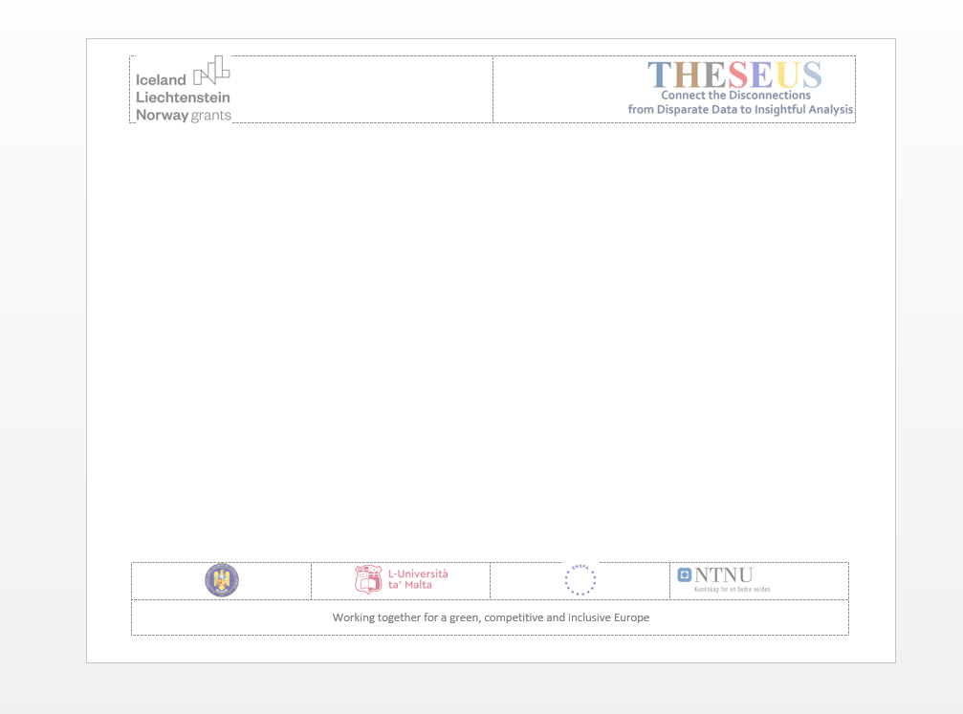
This publication was realised with the EEA Financial Mechanism 2014-2021 financial support. Its content (text, photos, videos) does not reflect the official opinion of the Programme Operator, the National Contact Point and the Financial Mechanism Office. Responsibility for the information and views expressed therein lies entirely with the author(s).
TEMPLATES
for Word docs and Power Point presentations will be provided

Slide 5

DISSEMINATION STRATEGY
This publication was realised with the EEA Financial Mechanism 2014-2021 financial support. Its content (text, photos, videos) does not reflect the official opinion of the Programme Operator, the National Contact Point and the Financial Mechanism Office. Responsibility for the information and views expressed therein lies entirely with the author(s).
TARGET GROUPS
OBJECTIVES AND RESPONSABILITY
GUIDELINES: INTERNAL AND EXTERNAL
EVALUATION

Slide 6



DISSEMINATION
STRATEGY
TARGET GROUPS
This publication was realised with the EEA Financial Mechanism 2014-2021 financial support. Its content (text, photos, videos) does not reflect the official opinion of the Programme Operator, the National Contact Point and the Financial Mechanism Office. Responsibility for the information and views expressed therein lies entirely with the author(s).
IN ACCORDANCE WITH THE PROJECT TARGET GROUPS:
(FUTURE) GOVERNANCE AND SOCIAL SCIENCES REPRESENTATIVES
(FUTURE) NATIONAL SECURITY PRACTITIONERS
GENERAL PUBLIC

Slide 7

DISSEMINATION
STRATEGY
OBJECTIVES AND RESPONSABILITY
This publication was realised with the EEA Financial Mechanism 2014-2021 financial support. Its content (text, photos, videos) does not reflect the official opinion of the Programme Operator, the National Contact Point and the Financial Mechanism Office. Responsibility for the information and views expressed therein lies entirely with the author(s).
OBJECTIVES
promote the Project and its results - courses
inform the target groups on the Program’s outline, thus contribute to the sustainability of the Project
develop the knowledge of the general public regarding the topic of the Project
Dissemination is coordinated by UoM. All partners have responsibilities in exploring the opportunities to disseminate the process, as well as specific components.

Slide 8

DISSEMINATION
STRATEGY
INTERNAL
This publication was realised with the EEA Financial Mechanism 2014-2021 financial support. Its content (text, photos, videos) does not reflect the official opinion of the Programme Operator, the National Contact Point and the Financial Mechanism Office. Responsibility for the information and views expressed therein lies entirely with the author(s).
Meetings
Communication
TPMs
virtual meetings
MVNIA to provide mailing list
virtual repository
all partners will have unity and coherence in communication
M3
RO - MVNIA
M12
MT - UoM
M24
RO - SNSPA
STTE / ToT
M16
NO - NTU
IP
M21
MT - UoM
M20
RO – MVNIA - SNSPA

Slide 9

This publication was realised with the EEA Financial Mechanism 2014-2021 financial support. Its content (text, photos, videos) does not reflect the official opinion of the Programme Operator, the National Contact Point and the Financial Mechanism Office. Responsibility for the information and views expressed therein lies entirely with the author(s).
Offline meetings and events
Multiplier events – 2 (MT and RO)
Training – during sustainability (MVNIA)
Scientific events - presentations of the Project and its results
DISSEMINATION
STRATEGY
EXTERNAL
UoM coordinates
Online presence
- all partners contributions -
Website
Pages on own websites
Social media –
Facebook

Slide 10
DISSEMINATION
STRATEGY
EXTERNAL
UoM coordinates
This publication was realised with the EEA Financial Mechanism 2014-2021 financial support. Its content (text, photos, videos) does not reflect the official opinion of the Programme Operator, the National Contact Point and the Financial Mechanism Office. Responsibility for the information and views expressed therein lies entirely with the author(s).
To be discussed:
Who purchases the platform/website?
Who administrates the platform/website?
Building content for the online presence
Who contributes
Deadlines

Slide 11
DISCLAIMER
This publication was realised with the EEA Financial Mechanism 2014-2021 financial support. Its content (text, photos, videos) does not reflect the official opinion of the Programme Operator, the National Contact Point and the Financial Mechanism Office. Responsibility for the information and views expressed therein lies entirely with the author(s).
This (select or insert the most adequate for your purpose) article/ document/ publication was realised with the EEA Financial Mechanism 2014-2021 financial support. Its content (text, photos, videos) does not reflect the official opinion of the Programme Operator, the National Contact Point and the Financial Mechanism Office. Responsibility for the information and views expressed therein lies entirely with the author(s).

Slide 12

This publication was realised with the EEA Financial Mechanism 2014-2021 financial support. Its content (text, photos, videos) does not reflect the official opinion of the Programme Operator, the National Contact Point and the Financial Mechanism Office. Responsibility for the information and views expressed therein lies entirely with the author(s).
Indicators | Measurement | Responsible
website access | 300 - 500 | UoM coordinates
subscriptions / engagement | 3% - 5% rate of subscribers
newsletters | 2
multiplier event | 100 - 150 participants | 1 - UoM 2 - MVNIA, SNSPA
 | minimum of participants number | partner in charge with organization
disemminated printed materials
academic presence | minimum 1 article published in a scientific journal | all partners collaboration and contribution
international conference | minimum of 1 - presentation of the Project
DISSEMINATION
STRATEGY
EVALUATION

Slide 13
After meeting documents
This publication was realised with the EEA Financial Mechanism 2014-2021 financial support. Its content (text, photos, videos) does not reflect the official opinion of the Programme Operator, the National Contact Point and the Financial Mechanism Office. Responsibility for the information and views expressed therein lies entirely with the author(s).
The following drafts will be provided to UoM:
Dissemination Strategy
Dissemination Plan
in order to be debated, agreed upon and shared to the responsible partners for implementation

Slide 14

This publication was realised with the EEA Financial Mechanism 2014-2021 financial support. Its content (text, photos, videos) does not reflect the official opinion of the Programme Operator, the National Contact Point and the Financial Mechanism Office. Responsibility for the information and views expressed therein lies entirely with the author(s).
Dissemination assistant
Gabriela Conțu (MVNIA)
Takk!
Mulțumesc!
Grazzi!

